Slide 1


#ScottishSummit2021
Kenny Lowe - @KennyLowe
Delving Deep into the new Azure Stack HCI
Alba : 15:00 GMT

Slide 2



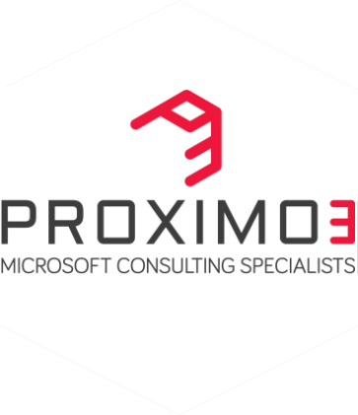

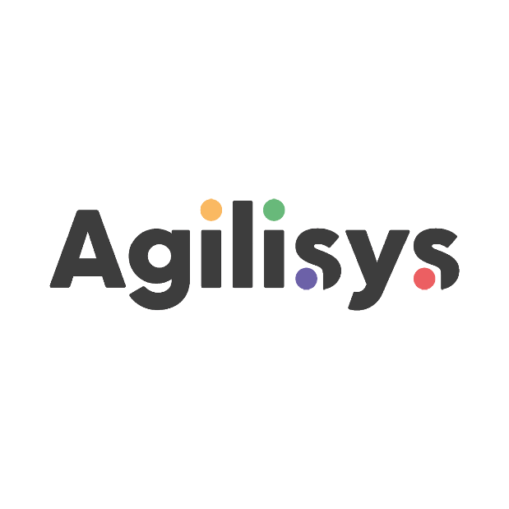

Our Sponsors

Slide 3
Why Hybrid Cloud?
#ScottishSummit2021

Slide 4



The Azure Public Cloud Today
70+
datacenter regions

Slide 5
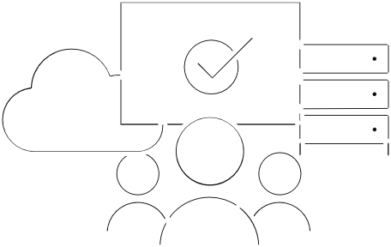
Hybrid Infrastructure with Microsoft Azure
Azure Arc
Extend Azure management capabilities
Run Azure data services from your choice of public or private cloud.
Microsoft Azure
Azure Arc
Azure Stack Hub
Azure Stack HCI
Azure Stack Edge
Bring Azure Services On Prem
Modernize Hyper-V Infrastructure with HCI
Azure ML/IoT services at the edge
Cloud-native integrated system
Disconnected scenarios
Data sovereignty
Application modernization
HCI connected to Azure
Scalable virtualization and storage
Remote branch office
High-performance workloads
Cloud-managed appliance
Machine learning at the edge
Edge compute and IoT solutions
Network data transfer to cloud
Purchase from OEM
Purchase from OEM
Azure Subscription

Slide 6
Azure Stack HCI is new… but it also isn’t…
Azure Stack HCI
Purpose Build Integrated Systems to deliver enterprise grade outcomes
Windows Server Software Defined (WSSD) Reference Architectures
S2D Ready Nodes w/ Windows Server 2016
S2D Ready Nodes w/ Windows Server 2019
‘Azure Stack HCI’
Really ‘Windows Server HCI’
2017
2018
2019
2020
2021
Notes:
Part of our distinct advantage over the competition is our pedigree with delivering Microsoft solutions – that is, our years of experience. With each evolutionary milestone in this journey of continuous innovation, we have learned and re-invested back into our Microsoft software defined and HCI solutions – weaving simplicity into every aspect of the product from ordering to deploying to maintenance to support.
WSSD RAs running on 13g PowerEdge servers
S2D Ready Nodes w/ Windows Server 2016 – Included Support and Services. First major vendor to take 100% product approach instead of Reference Architectures.
S2D Ready Nodes w/ Windows Server 2019 – 1000+ customers worldwide. Introduced Dell EMC OpenManage Integration with Windows Admin Center 1.0.
Dell EMC HCI Solutions for Microsoft Windows Server – THIS IS THE NEW BRAND NAME THAT WE WILL USE GOING FORWARD. Version 1.1 of OpenManage Integration with WAC that included LCM using Cluster-Aware Updating.

Slide 7




Growing Azure Stack HCI into its own product line
Azure Stack HCI
Windows Server
Exciting roadmap of new releases
Exciting roadmap of new releases
Innovation focused on being the
best virtualization host
Innovation focused on being the
best guest and traditional server
Future of Hyper-V virtualization,
software-defined storage and networking
All other Windows Server roles,
like IIS, File Services, DNS, DHCP, AD/DS
Run apps inside Windows or Linux virtual machines
Runtime for Windows apps like SQL Server
Runs on your hardware
Runs anywhere

Slide 8


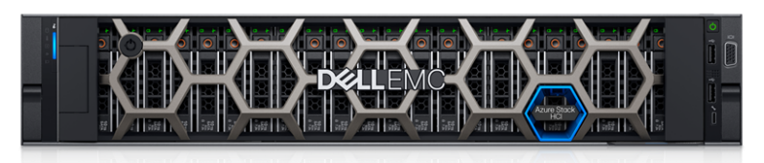
INTRODUCING
Integrated Systems for Microsoft Azure Stack HCI
Modernize and Transform your Operational Experience
Streamline & Simplify Operations
Deliver Operational Efficiency
Integrated Azure Experience
Flexible Consumption Options
Be Confident
Rely on enterprise-class expertise

Slide 9



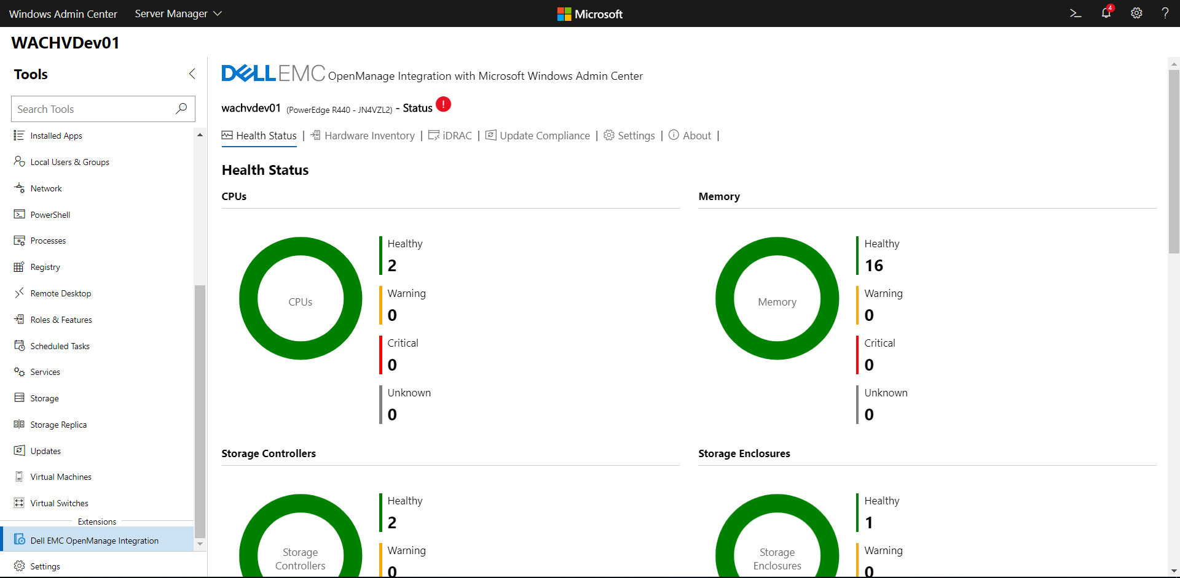

Hybrid Infrastructure with Azure Stack HCI
Customer Applications
Virtual Apps
Cloud Native Apps
Azure Services
Connect to Azure Services such as Azure Monitor, Update, Site Recovery, etc.
Azure Arc enabled data services* bring Azure services such as Azure SQL, Azure Postgres SQL hyperscale on-prem, but managed as Azure service
Virtual Machines
Azure Kubernetes Service (AKS)*
Awesome features such as stretched clusters, Arc integration and management
Announced – Azure Kubernetes Service on HCI – enables traditional VMs and K8 clusters to run on same infrastructure
Azure Stack HCI OS
[ Hyper-V + Storage Spaces Direct + SDN ]
Azure Stack HCI – hybrid HCI OS available as an Azure Service
Always up to date and current as part of Azure subscription
Billed as any other Azure service with $10/core/month
Managed locally or via Azure portal using Arc
Azure Stack HCI Integrated System
Integrated Systems for Azure Stack HCI
Turnkey HCI appliance with simplified deployment and LCM
Local management via Windows Admin Center (WAC) and WAC Extensions
* At this time, available as preview from Microsoft

Slide 10












What is the new Azure Stack HCI?
Purpose-built HCI operating system delivered as an Azure service
Enterprise class hyperconverged infrastructure
Azure hybrid by design
Familiar management and operations
Hyper-V for secure, efficient virtualization of Windows and Linux
Storage Spaces Direct for fast enterprise-grade storage
Azure inspired software defined networking
NEW! Stretched clustering for disaster recovery
NEW! Azure Stack HCI resource provider
NEW! Management and governance with Azure control plane via Azure Arc and Azure Portal
NEW! Always up-to-date subscription
NEW! Native integration with Azure services
Leverage existing concepts and skills in virtualization and storage
Manage with Windows Admin Center, System Center, PowerShell
Continue to leverage 3rd party tools for monitoring, security, and backup/restore

Slide 11
Demo time! Let’s get some real-world knowledge on!

Slide 12
What is Azure Stack HCI?
The future of on-premises virtualisation from Microsoft
Enterprise-grade, high performance, affordable, extremely easy to manage
An Azure service, and a core part of any Azure strategy

Slide 13
Our Sponsors

Slide 14
Thank You
#ScottishSummit2021

